Slide 1

Faculty of Computer and Information Sciences Ain shams University
Information Systems Department (2022-2023)

Slide 2

Real-Estate Smart Prediction System

Slide 3
Supervisor:
Dr. Sherine Rady

Slide 4
TA:
Dr. Amal Moustafa

Slide 5
Team members:
Abeer Ahmed Sholkamy.
Abdelrahman Mohammed Ahmed.
Amany Adel Soliman.
Shehab Adel Abdelgleel.
Osama Ahmed Ahmed.
Esraa Mohammed Abdelhamid.

Slide 6
Agenda:
Introduction.
Problem definition
Motivation
Objective
Time Plan
Dataset
System Architecture.
Main functions
Experimental results.
Software Tools
Demo
Conclusion and future work
References.

Slide 7

Introduction:
Real-Estate market in Egypt has always been challenging to deal with many features in the estate define it's values and our part is to let you know which one of them matters the most.

Slide 8

Problem Definition:
In a market like Egypt it is very hard to find an appropriate estate with a reasonable price, owner find trouble in finding a buyer.

Slide 9
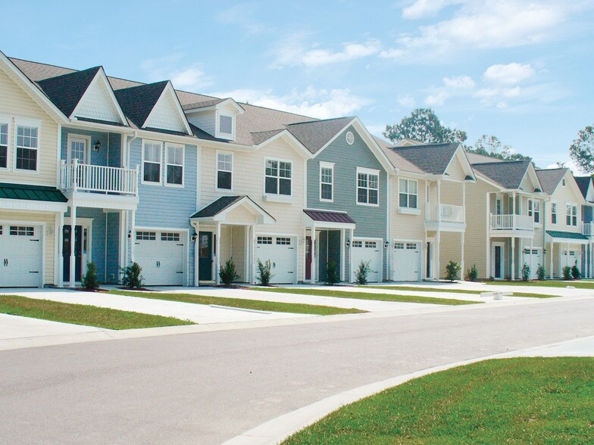
Motivation:
Real estate systems are essential because they streamline the buying, selling, renting, and managing of real estate assets. They provide real estate professionals with the tools and data they need to make informed decisions and reduce transaction times.

Slide 10

Objective:
Offering help in finding the estate you need in fastest time and easiest way.
Help you to sell your estate.
Predicting the price of a estate based on the giving features.
Prediction whether the estate appropriate for investment or not?

Slide 11
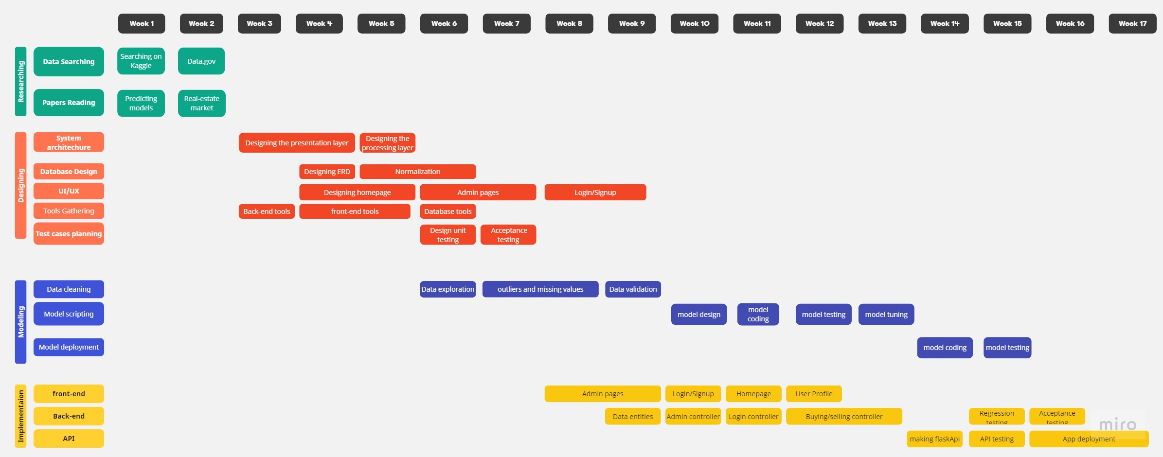
Time Plan

Slide 12

Dataset:
Egypt villas price depending on amenities and city locations 2022.

Slide 13
Attributes of dataset:
Type
Price
Bedrooms
Bathrooms
Area
Furnished
Compound
Payment_Option
Delivery_Date
Delivery_Term
City
Description
Private_Garden
Security
Balcony
Pets_Allowed
Covered_Parking
Maids_Room
Electricity_Meter
Natural_Gas
Landline
Pool
Central_heating
Built_in_Kitchen_Appliances
Elevator

Slide 14
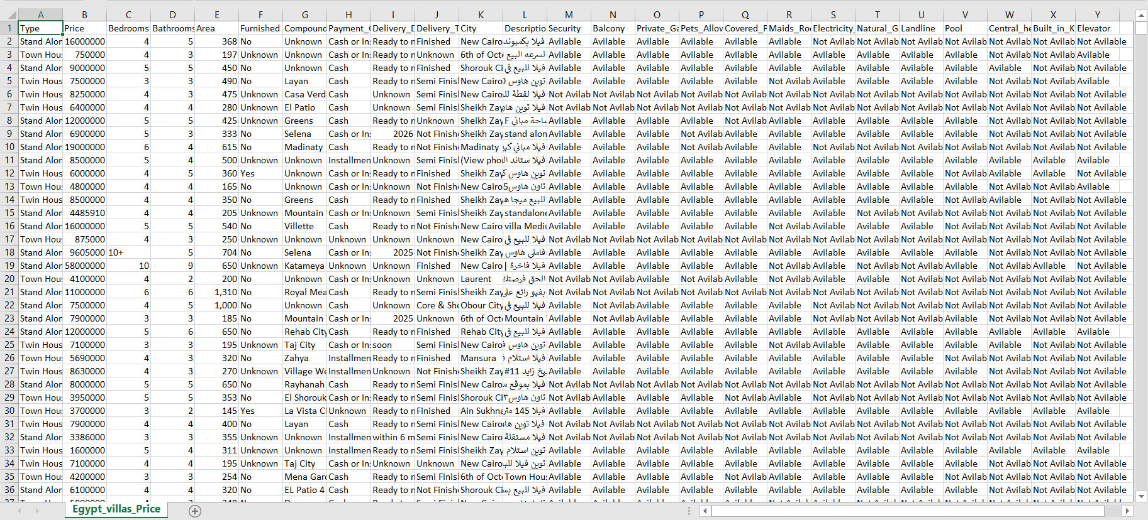
Project analysis slide 10
Dataset(Egypt_villas_price)

Slide 15
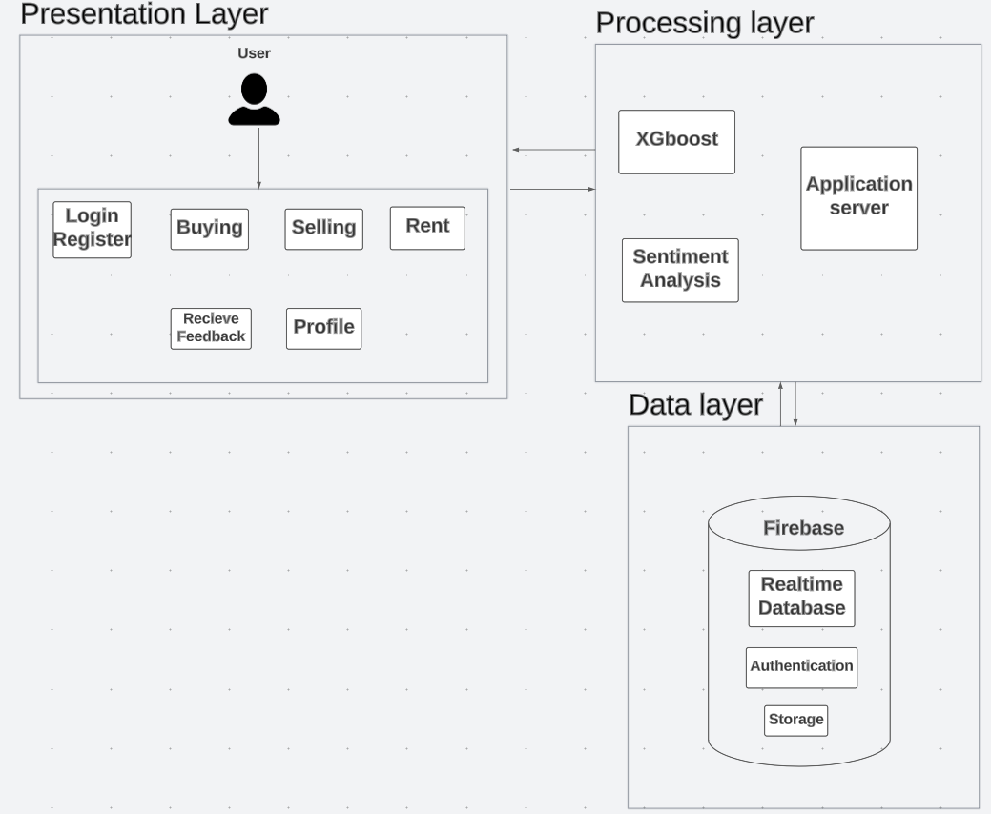
System Architecture

Slide 16
Main Functions
Users can register & log in.
Each user have a profile with public rate.
Filtering estates by buy, rent, interested and offers.
Search by price, area and city
User can either rent or offer his estate for rent.
Each user can buy or sell.
Prediction for price by area and some features.
Rating and reviewing user happen after the completion of the deal.
Show best seller according to how many estates he sold.

Slide 17

Algorithms

Slide 18
XGBoost Algorithm
To predict price
XGBoost is a popular algorithm for solving supervised learning problems, such as regression and classification.
XGBoost is a popular algorithm for solving supervised learning problems, such as regression and classification.

Slide 19
XGBoost Algorithm
measure the performance by using Mean Squared Error and Mean Absolute Error
MSE = (1/n) * Σ (yᵢ - ȳ) ²
MAE = (1/n) * Σ|yᵢ - ȳ|
using Mutual Information Regression to measure the statistical dependence between two variables, the mutual information between the predictor variable(s) and the target variable is estimated.
I(X;Y) = ∑ ∑ p(x,y) log(p(x,y) / (p(x) * p(y)))

Slide 20
XGBoost Algorithm
Results of using XGboost
Importance of features using XGboost
 | XGboost
Mean absolute error | 1926584.31
Mean squared error | 7823557174860.56
Median absolute error | 1337249.75
Explain variance score | 0.69
R2 score | 0.69
Area | 0.863977
Payment_Option | 0.228052
Bathrooms | 0.121363
Bedrooms | 0.083963
Pool | 0.050154
Elevator | 0.030619
Pets_Allowed | 0.029793

Slide 21
ANN Algorithm
Results of using ANN
Importance of features using ANN
 | ANN
Mean absolute error | 709162.66
Mean squared error | 1334609082788.72
Median absolute error | 428703.5
Explain variance score | 0.56
R2 score | 0.56
Area | 0.491899
Bathrooms | 0.190262
Payment_Option | 0.131922
Bedrooms | 0.111004
Delivery_Date | 0.095696
Delivery_Term | 0.090273
Type | 0.086459

Slide 22
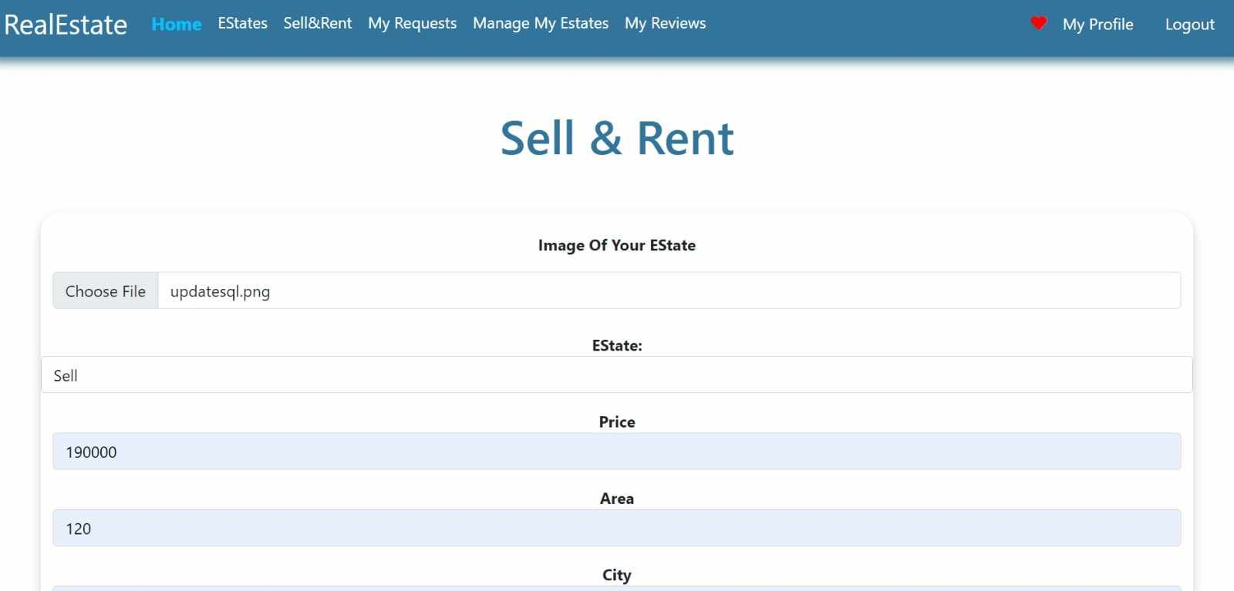
XGBoost Algorithm
Enter the estate’s features and wait to show the predicted price

Slide 23
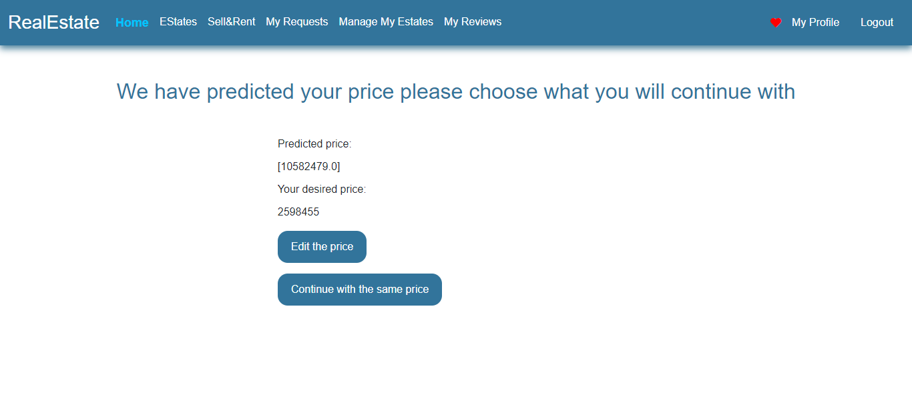
XGBoost Algorithm
Enter the estate’s features and wait to show the predicted price

Slide 24
Sentiment Analysis
Sentiment analysis, also known as opinion mining, is the process of determining and analyzing the emotional tone or sentiment expressed in a piece of text, such as reviews.
Using sentiment analysis to evaluate the rate of the user based on reviews.
The purpose of model to provide flask web app, that takes sentence(review) as input and using VADER tool in NLTK library, the app return JSON object containing sentiment label (“positive”, “negative”).
VADER tool take sentence and calculate score for it, score in range -1 (most negative) to 1 (most positive).
Sentence is “Positive” if score is greater than 0 and “negative” otherwise.

Slide 25
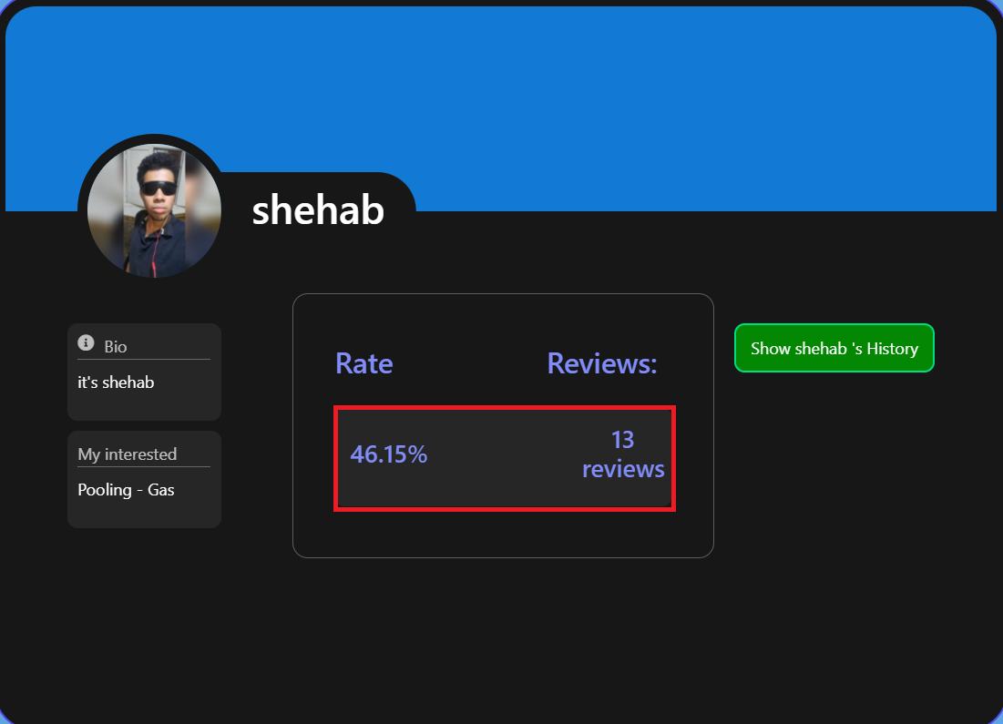
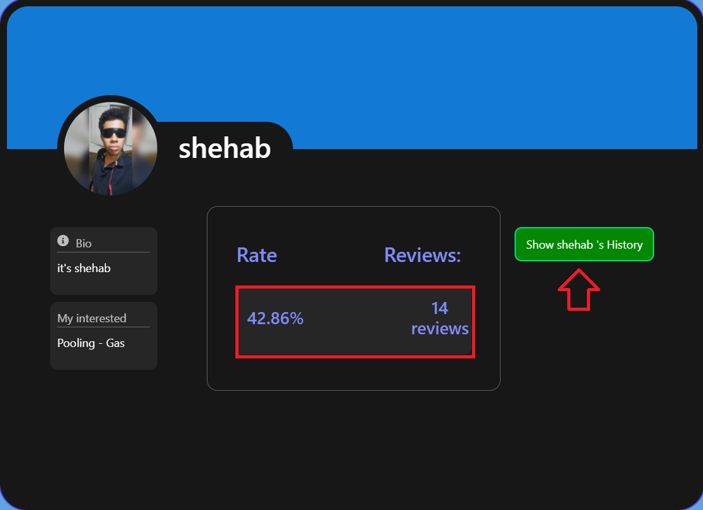
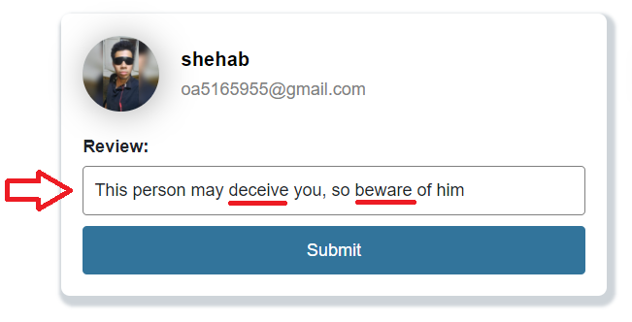
Sentiment Analysis
Before make Bad review:
After make Bad review:
Let’s add Bad review:

Slide 26
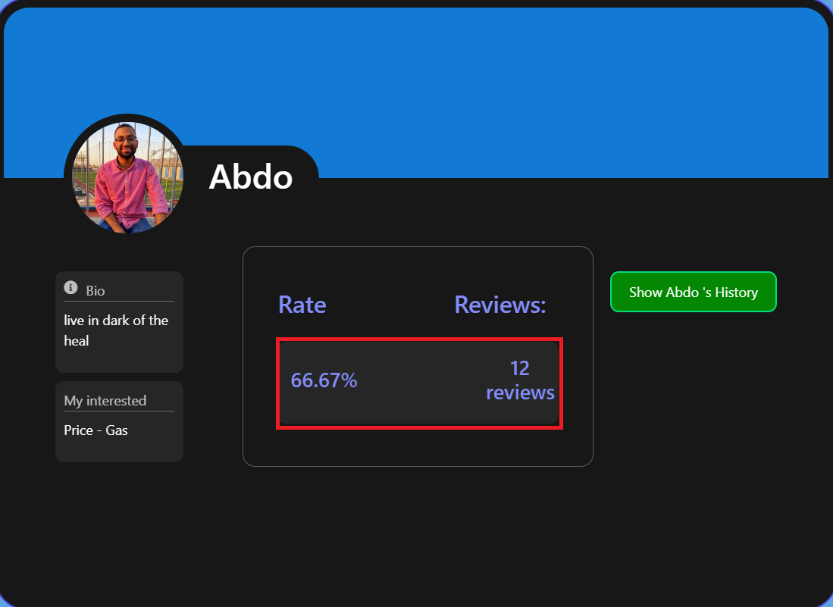
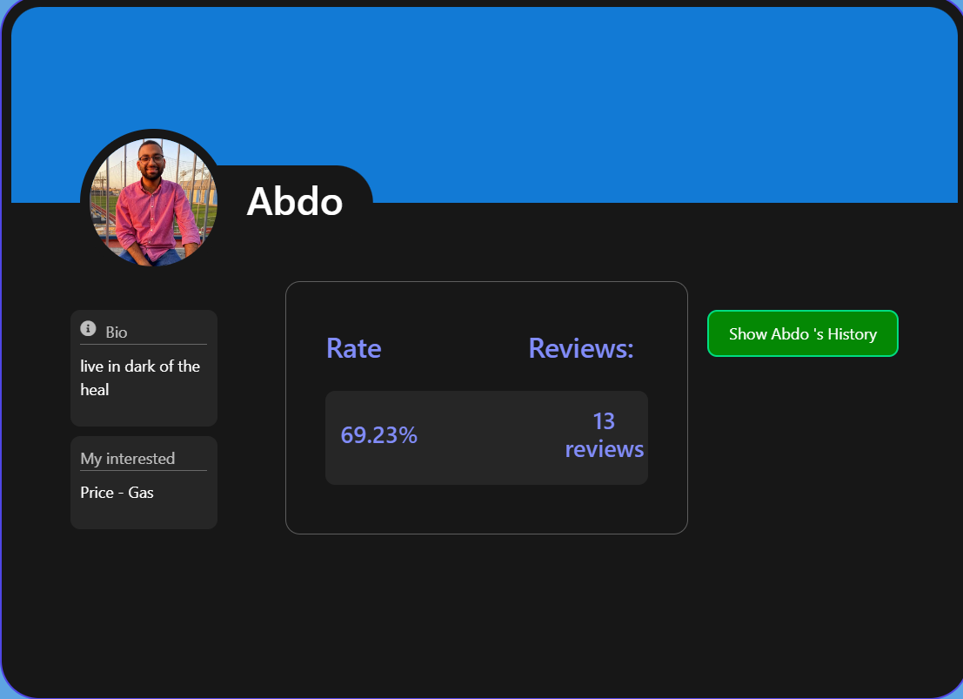
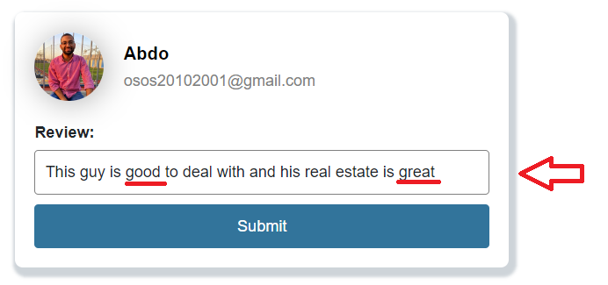
Sentiment Analysis
Before make Good review:
After make Good review:
Let’s add Good review:

Slide 27




Software Tools:
C# & .Net framework
To manage back-end.
Python in Machine Learning and using flask API to expose system’s functionality to other systems.
HTML , CSS & JS
React to design
front-end.
Storage

Slide 28
Conclusion
After completing the project with all the models achieving their goals, the main outcome resolved was that the area of a property is the most important factor in determining the price of the property.
The importance of this system comes from the market analysis, determining the pricing strategies and saving time for customers to find the appropriate property for them to buy or rent or even sell.

Slide 29
Future work
Social Collaboration
Blockchain Integration
Virtual Reality (VR) and Augmented Reality (AR)
CNN

Slide 30
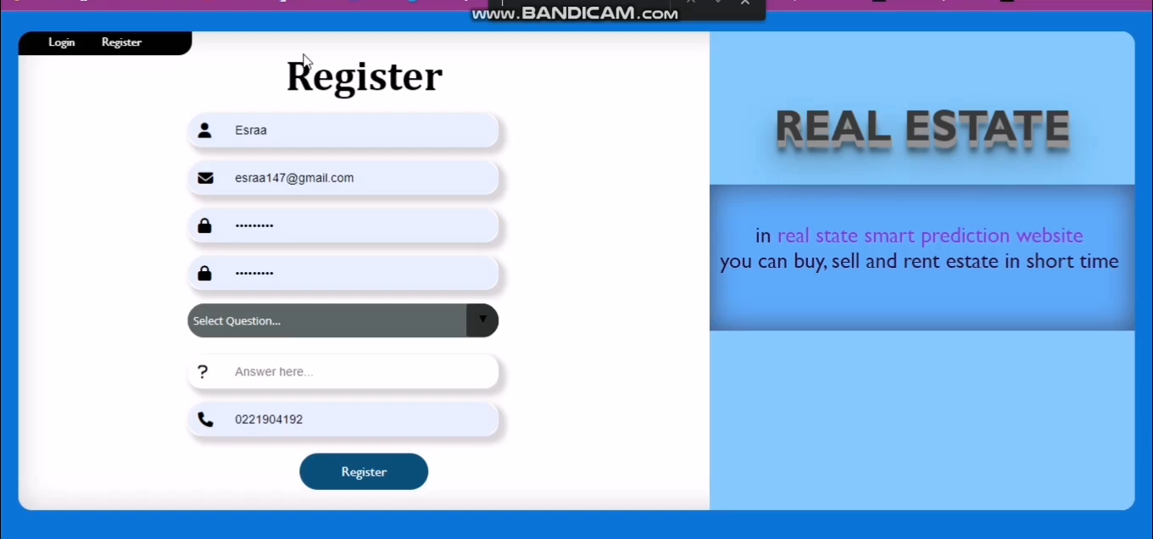

Slide 31
References:
[1] Varma, A., Sarma, A., Doshi, S. et al.: House Price Prediction Using Machine Learning and Neural Networks. 2018 Second International Conference on Inventive Communication and Computational Technologies (ICICCT), 1936-1939 (2018).
[2] Henry, C., Paul, D., Theo, D., Stephen A. J.: A spatio-temporal, Gaussian process regression, real-estate price predictor. In Proceedings of the 24th ACM SIGSPATIAL International Conference on Advances in Geographic Information Systems (SIGSPACIAL '16). Association for Computing Machinery, New York, NY, USA, Article 68, 1–4 (2016).
[3] Aswin Sivam Ravikumar, School of Computing , National College of Ireland, Real Estate Price Prediction Using Machine Learning , December 2017.
[4] X. Ren, H. Guo, S. Li and S. Wang and J. Li, "A Novel Image Classification Method with CNN-XGBoost Model", International Publishing in Digital Forensics and Watermarking, pp. 378-390, 2017.

Slide 32
Thank you

